Slide 1
The Undefined

Slide 2
What is HyperText Markup Language?

Slide 3
Some history

Slide 4
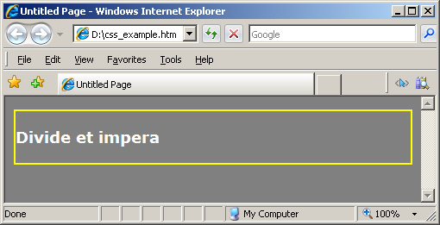
<body bgcolor=“Gray">
<div border=“2" bordercolor=“yellow">
<p>
<font face="verdana" color=“white">Divide et impera</font>
</p>
</div>
</body>

Slide 5
<body style="background-color:Gray">
<div style="border:2px yellow">
<p style="font-family:verdana; color:white">Divide et impera</p>
</div>
</body>

Slide 6
<head>
<style type="text/css">
body { background-color:Gray; }
div { border:2px yellow; }
p { font-family:verdana; color:white; }
</style>
</head>
<body>
<div>
<p>Divide et impera</p>
</div>
</body>

Slide 7
<link href="styles.css" type="text/css" rel="stylesheet" media="screen" />
index.html
<head>
<link type="text/css“ media="screen" rel="stylesheet" href="styles.css" />
</head>
<body>
<div>
<p>Divide et impera</p>
</div>
</body>
styles.css
body { background-color:Gray; }
div { border:2px yellow; }
p { font-family:verdana; color:white; }

Slide 8
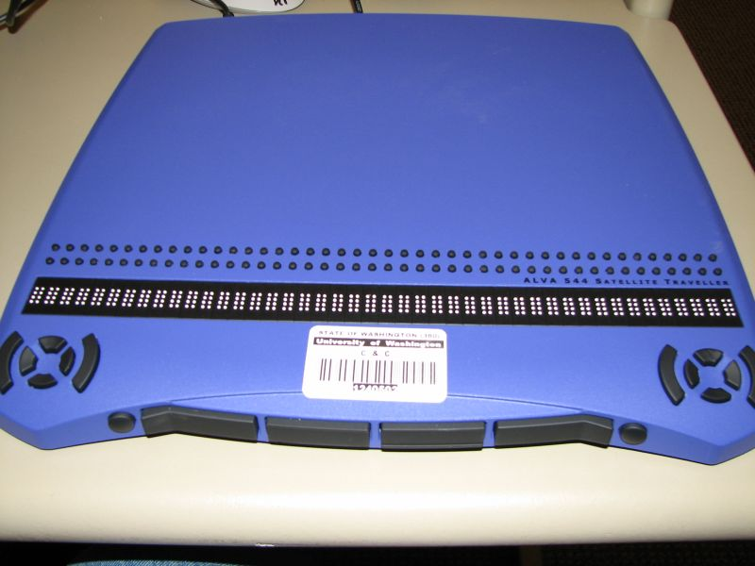
CSS Media Types
Media Type | Description
all | Used for all media type devices
aural | Used for speech and sound synthesizers
braille | Used for braille tactile feedback devices
embossed | Used for paged braille printers
handheld | Used for small or handheld devices
print | Used for printers
projection | Used for projected presentations, like slides
screen | Used for computer screens
tty | Used for media using a fixed-pitch character grid, like teletypes and terminals
tv | Used for television-type devices
media=“screen and (max-device-width: 480px)"
media=“screen and (orientation:portrait)"

Slide 9
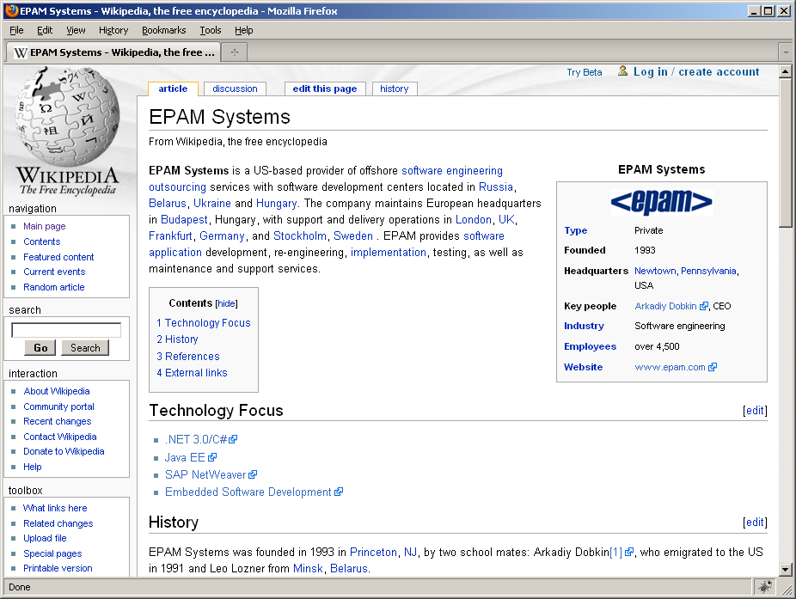
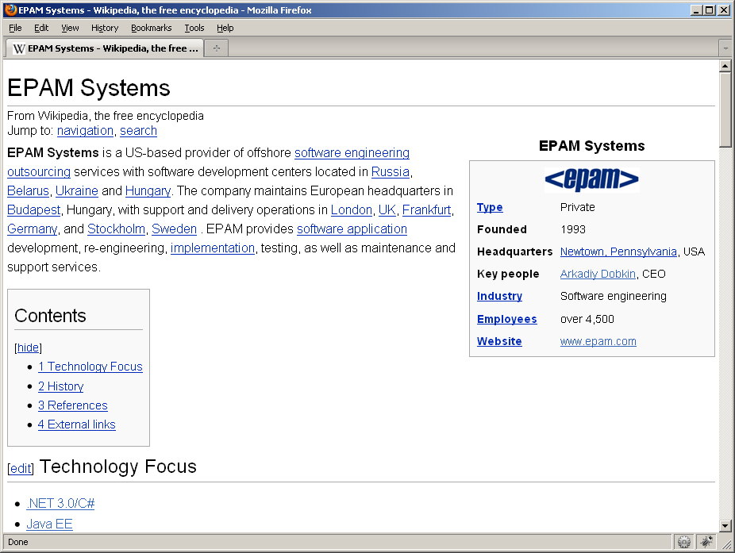
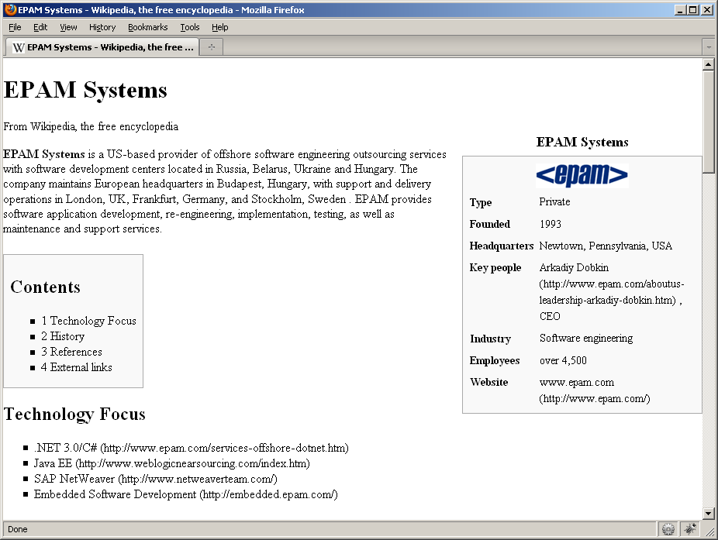
screen.css
HTML
handheld.css
print.css

Slide 10
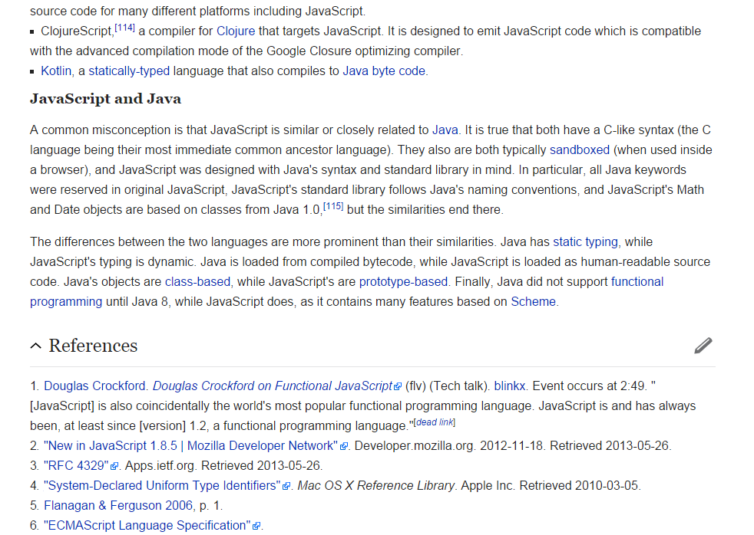
Wikipedia

Slide 11
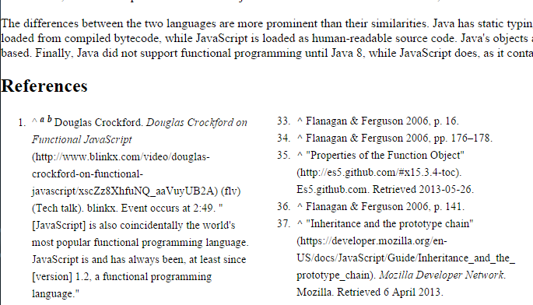
Wikipedia – print view

Slide 12
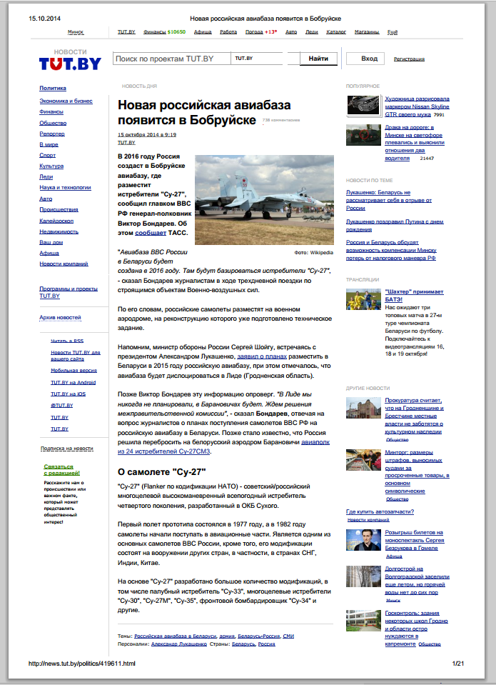

Slide 13
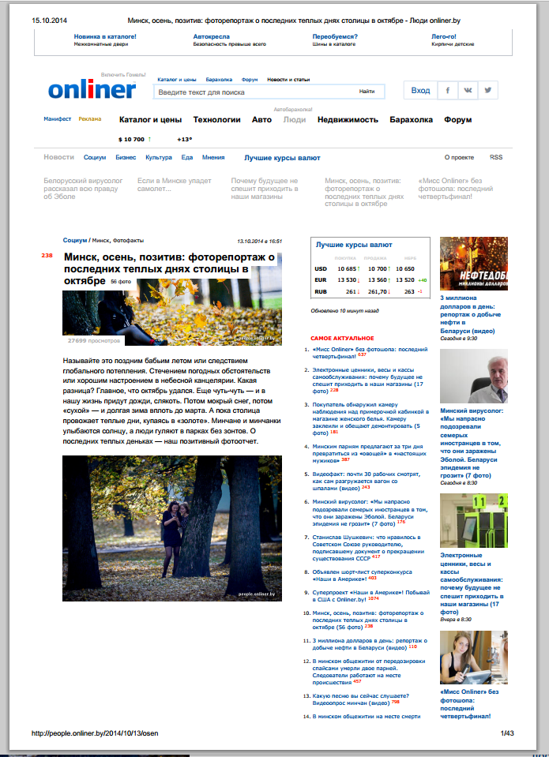

Slide 14
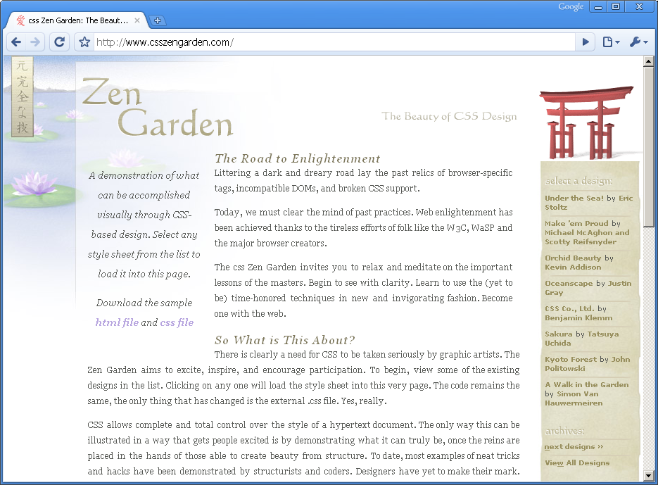

Slide 15
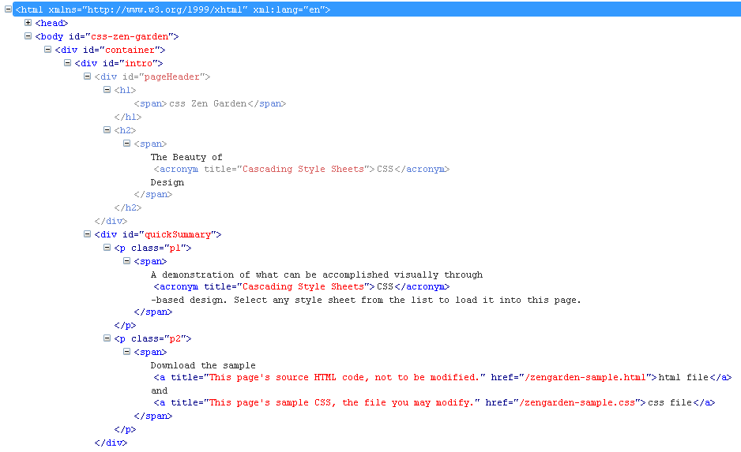
http://csszengarden.com/

Slide 16
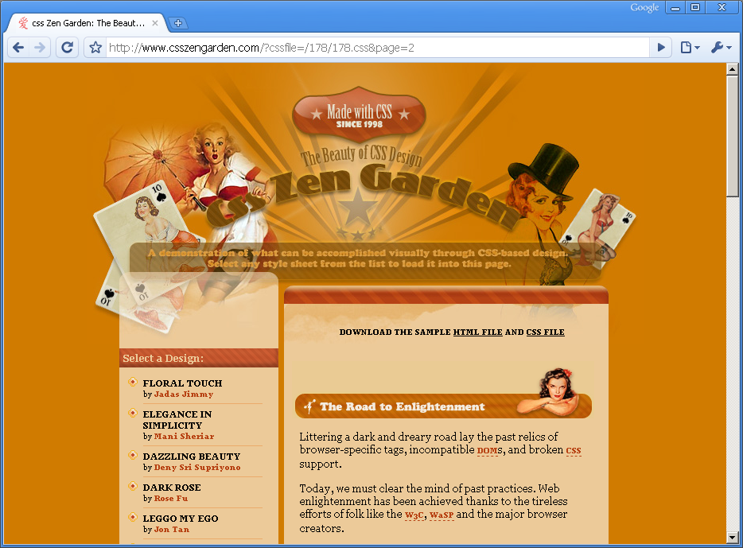

Slide 17
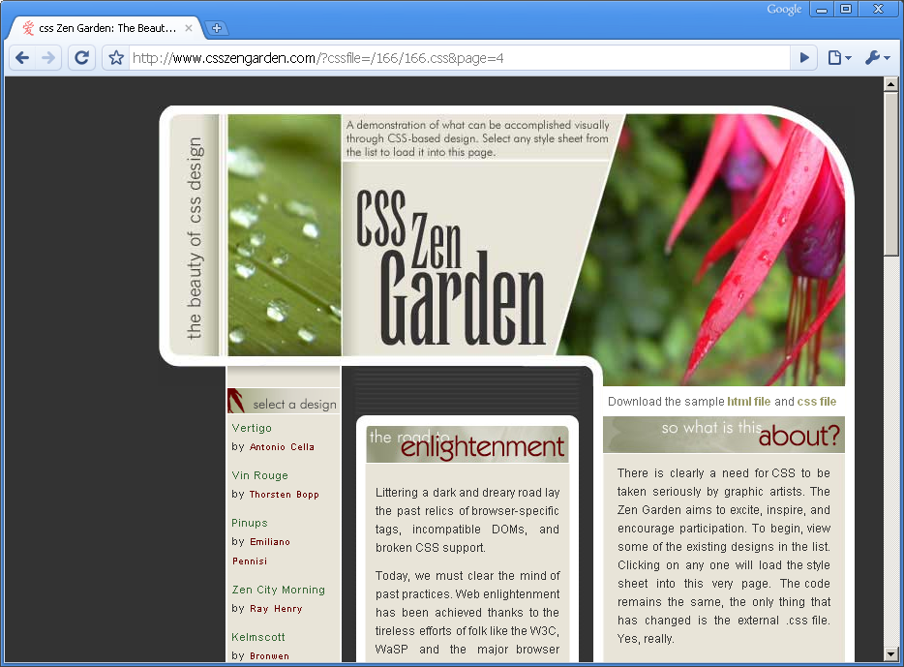

Slide 18
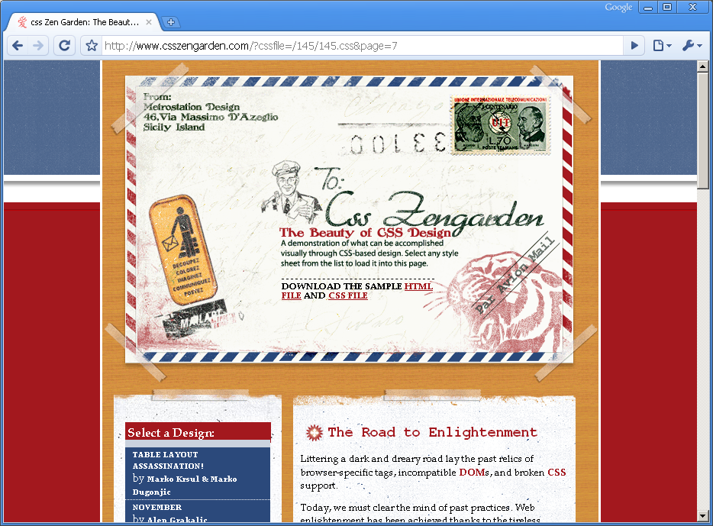

Slide 19
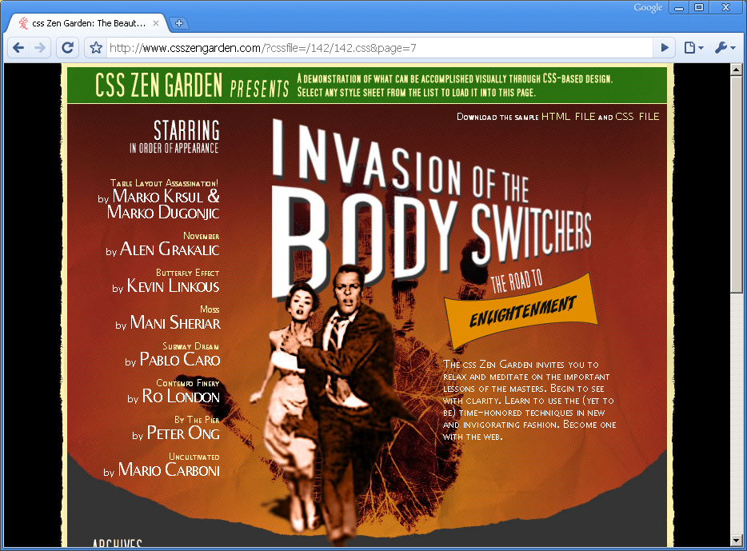

Slide 20
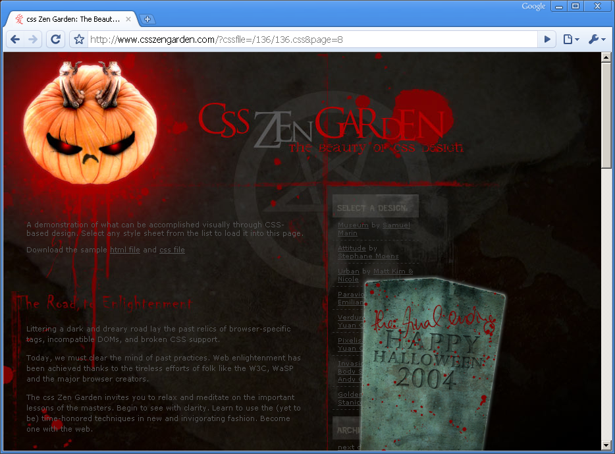

Slide 21
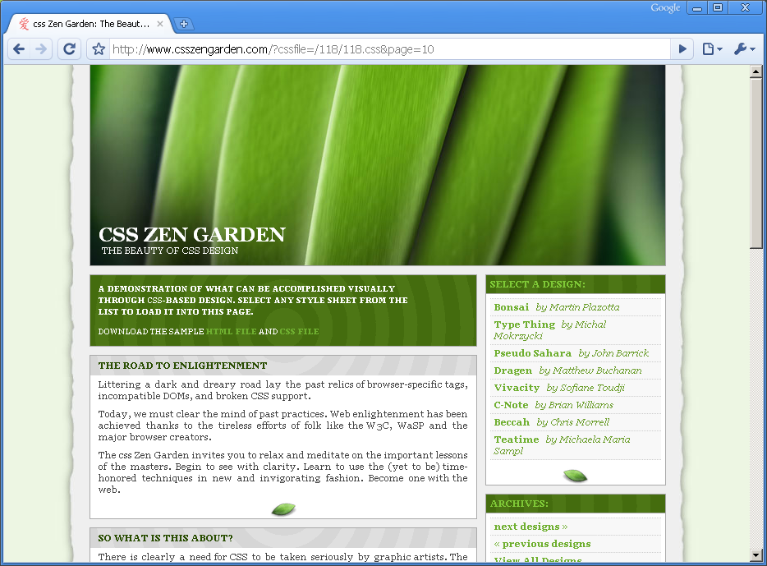

Slide 22
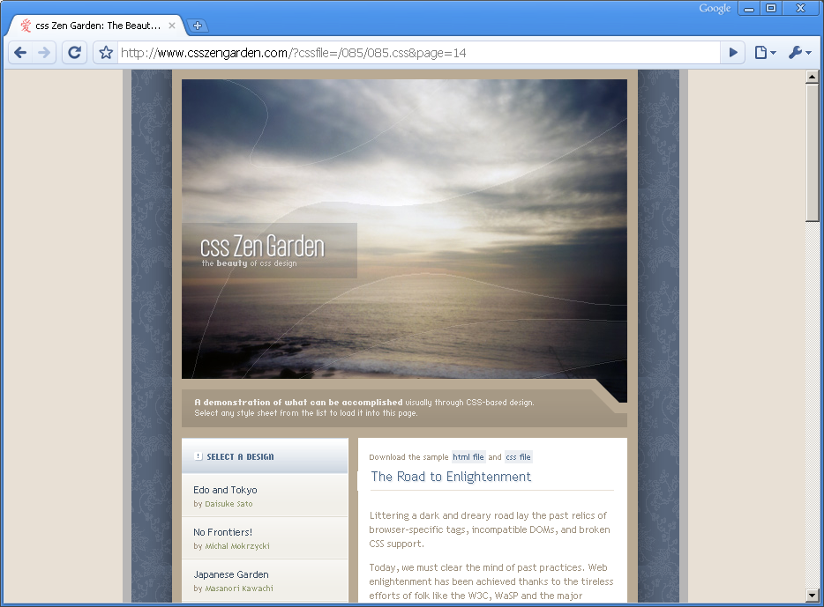

Slide 23
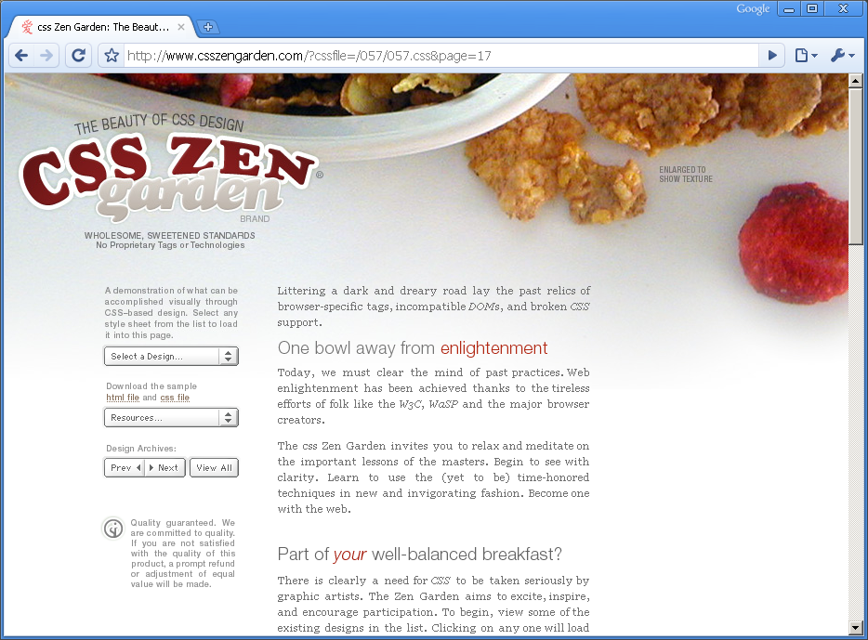

Slide 24
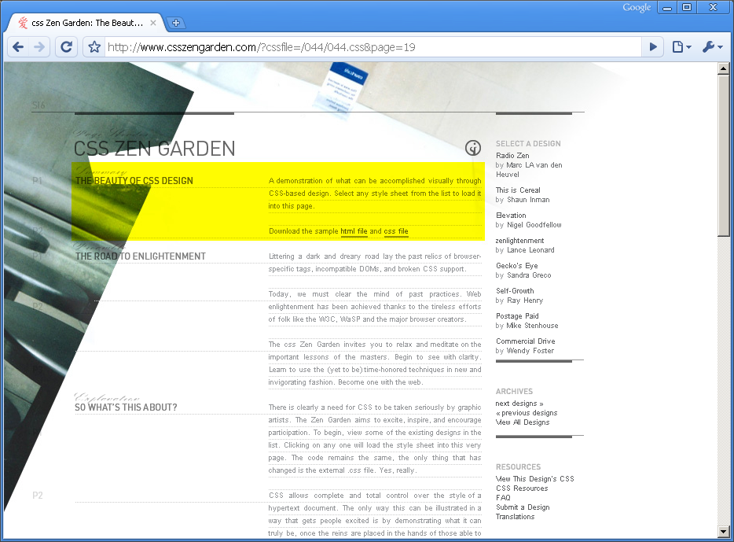

Slide 25
http://www.csszengarden.com/

Slide 26
Real world

Slide 27
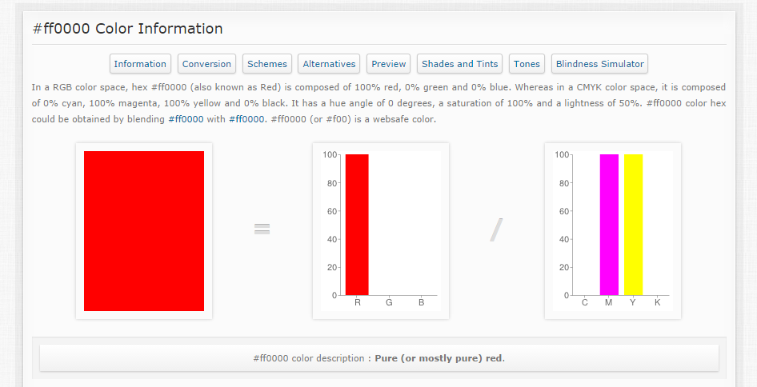
Red

Slide 28
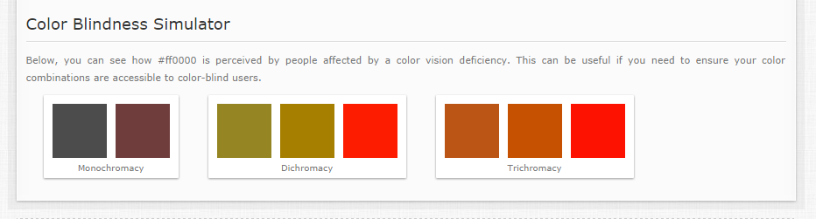
Colorblind
http://www.colorhexa.com/ff0000
http://designshack.net/articles/accessibility/tips-for-designing-for-colorblind-users/

Slide 29
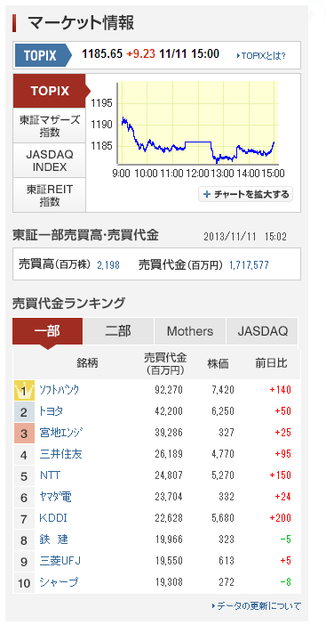
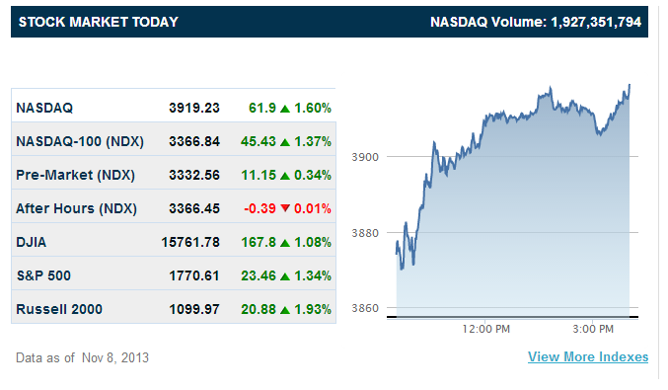

Slide 30
Use proper class names
<h2 class=“red">Main article</h2>
<p class="green">Article summary</p>
<h2 class="title">Main article</h2>
<p class="summary">Article summary</p>

Slide 31
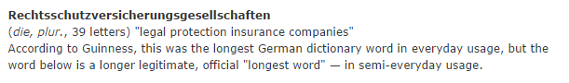
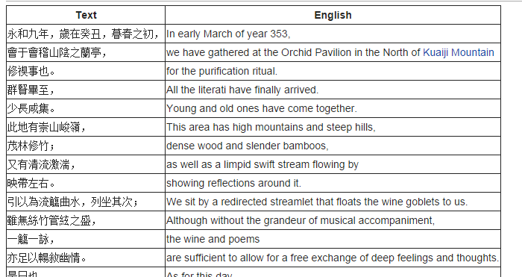
Language

Slide 32
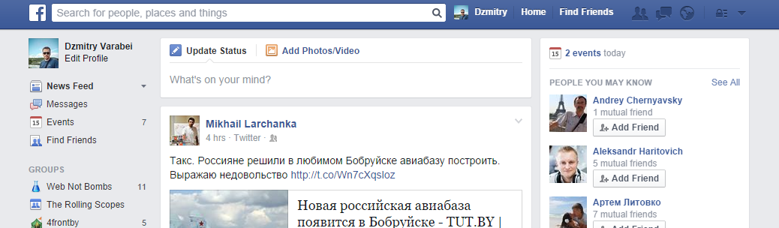
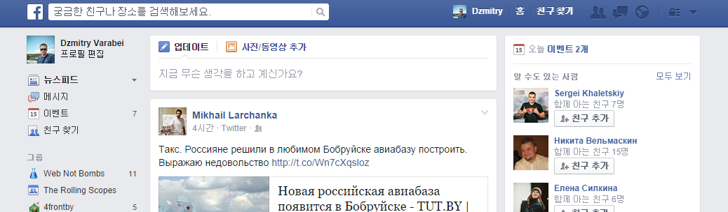

Slide 33
Semantic markup

Slide 34
Rich snippets
Microformats
RDFa (Resource Description Framework in attributes)
Microdata

Slide 35
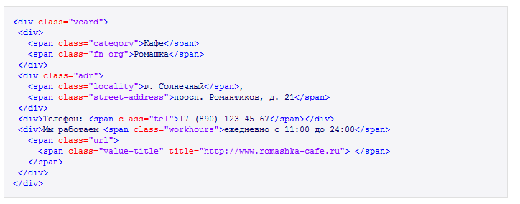
Microformats
Text
Кафе Ромашка
г. Солнечный, просп. Романтиков, д. 21
Телефон: +7 (890) 123-45-67
Мы работаем ежедневно с 11:00 до 24:00
HTML

Slide 36
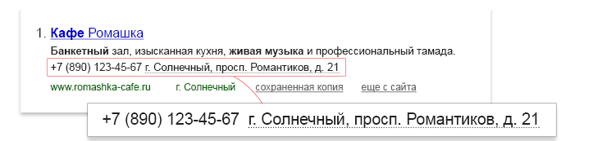
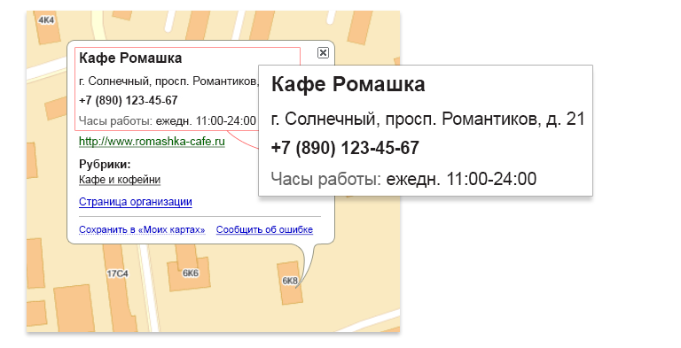
Microformats
Yandex
Yandex Maps

Slide 37
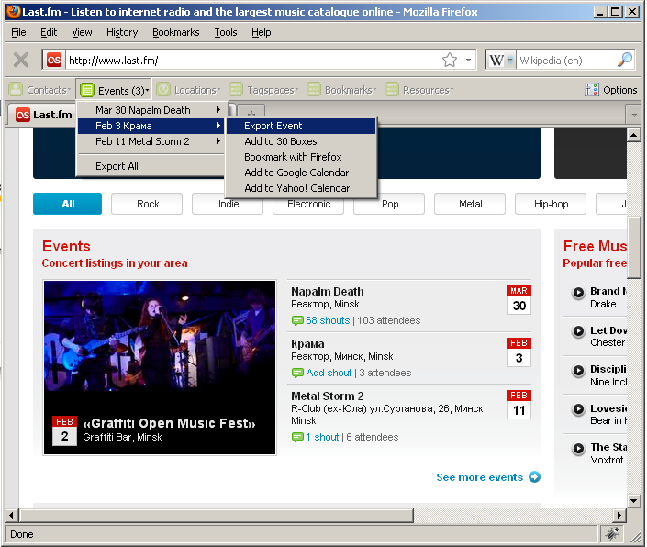

Slide 38
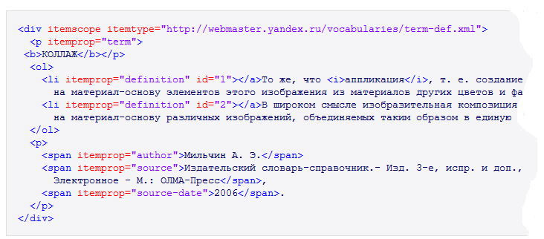
Microdata

Slide 39
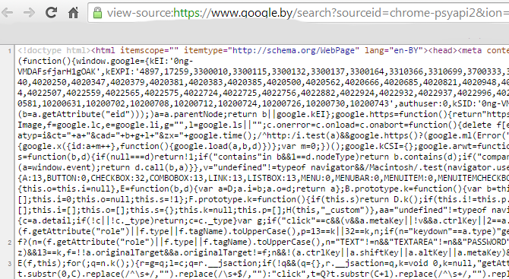
http://schema.org/

Slide 40
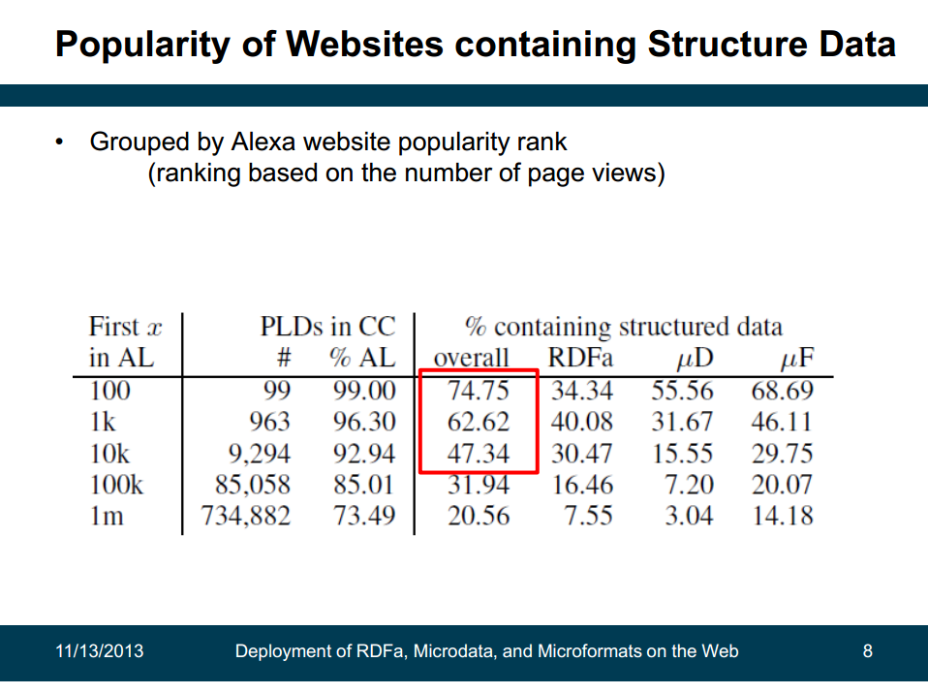

Slide 41
Screen

Slide 42
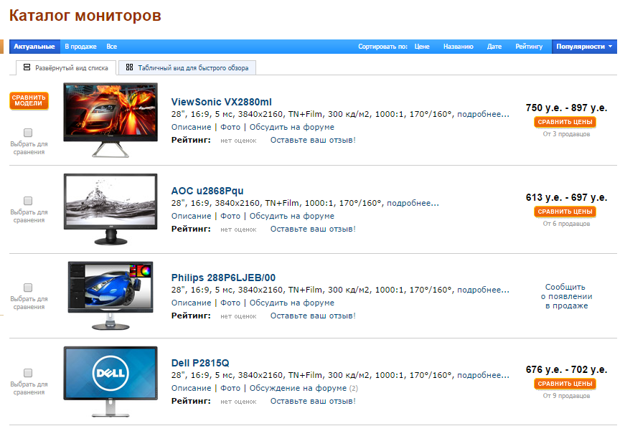

Slide 43
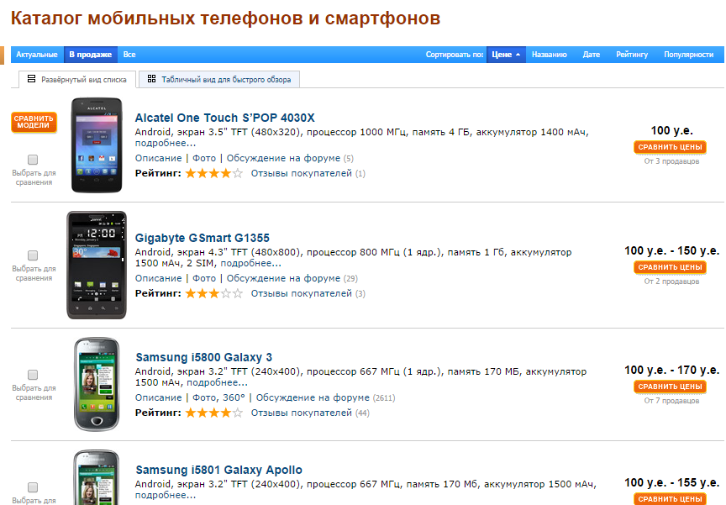

Slide 44
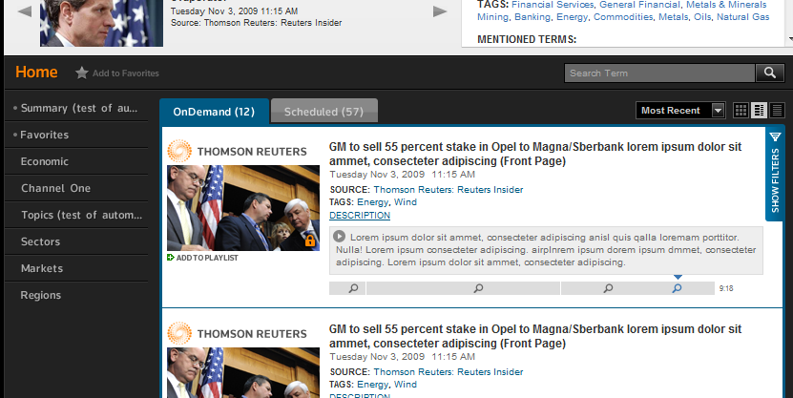

Slide 45


Slide 46
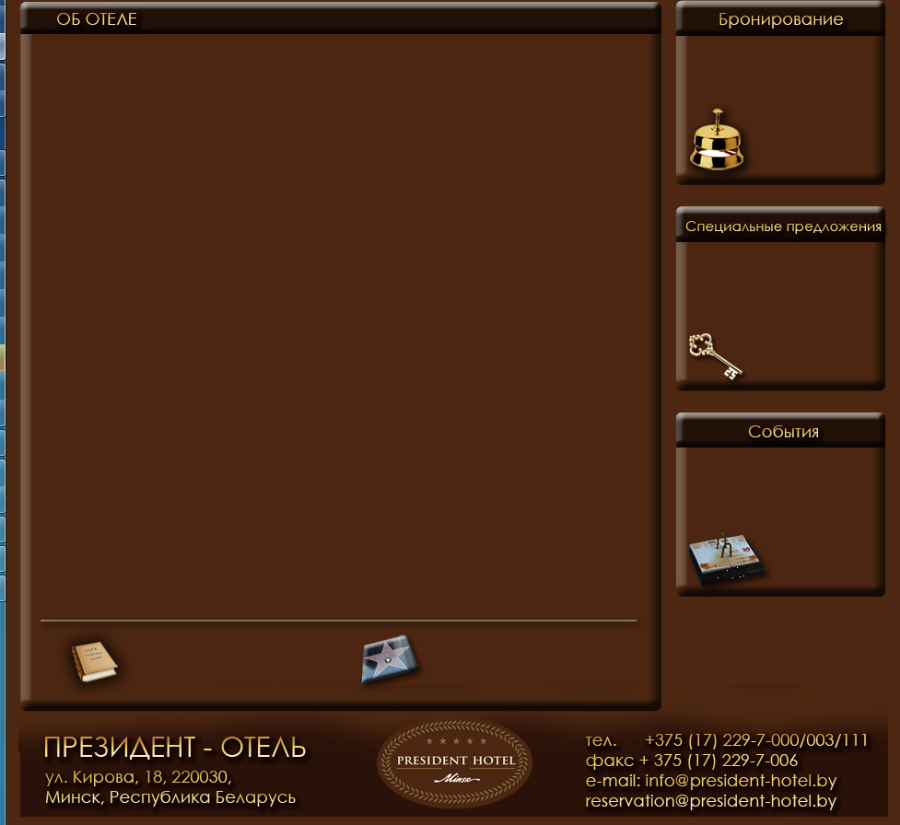

Slide 47
Real content (TODO)

